Slide 1
Teck Ghee Heartland 416

Slide 2
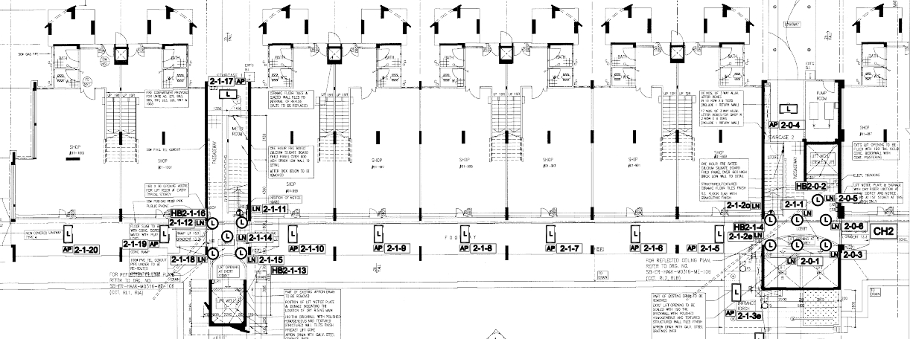
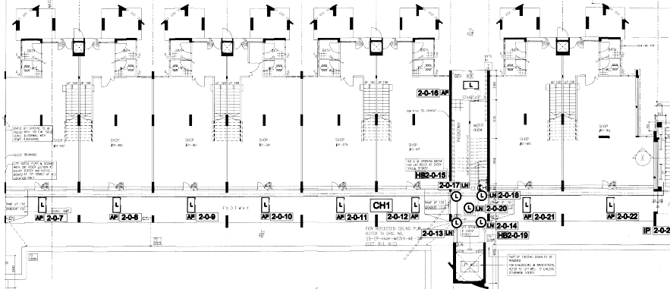
Block 416 1st STOREY FLOOR PLAN

Slide 3
STAIR 1
STAIR 2
STAIR 3
1003
1001
999
997
995
993
991
989
987
985
983
981
979
977
975
973
CSR
COMMON CORRIDOR
COMMON CORRIDOR
B
A
D
LOBBY B, A
C
LOBBY D
LOBBY C

Slide 4
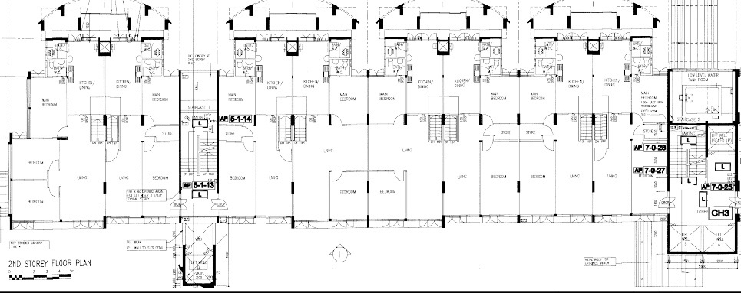
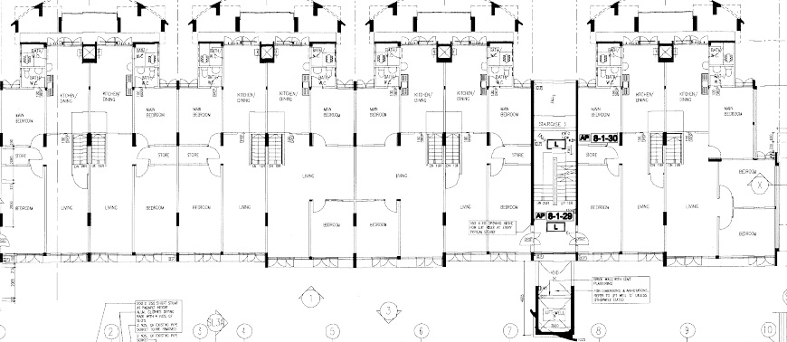
Block 416 2nd STOREY FLOOR PLAN

Slide 5
STAIR 1
STAIR 2
STAIR 3
1003
1001
999
997
995
993
991
989
987
985
983
981
979
977
975
973
B
A
D
LOBBY B, A
C
LOBBY D
LOBBY C

Slide 6
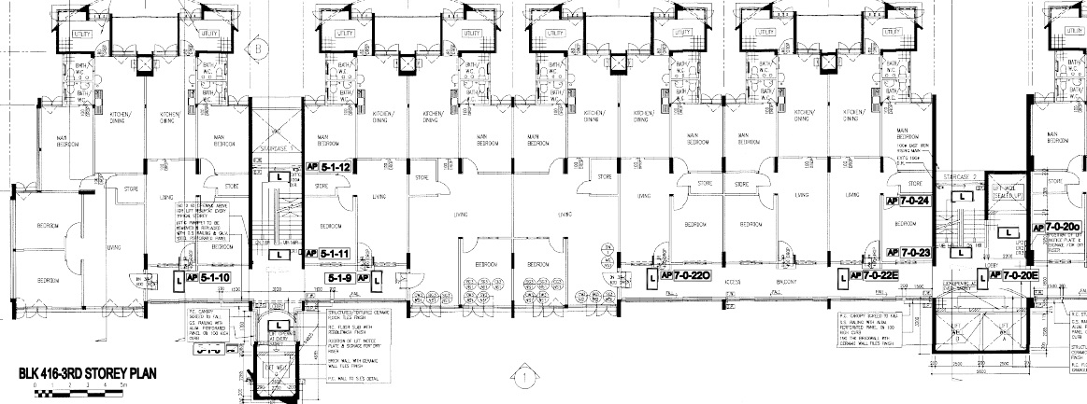
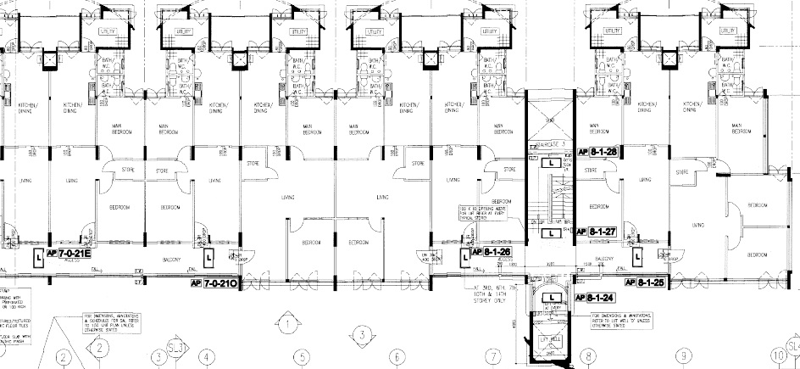
Block 416 5th, 9th AND 13th STOREY FLOOR PLAN

Slide 7
STAIR 1
STAIR 2
STAIR 3
1003
1001
999
997
995
993
991
989
987
985
983
981
979
977
975
973
COMMON CORRIDOR
COMMON CORRIDOR
B
A
D
LOBBY B, A
C
LOBBY D
LOBBY C

Slide 8
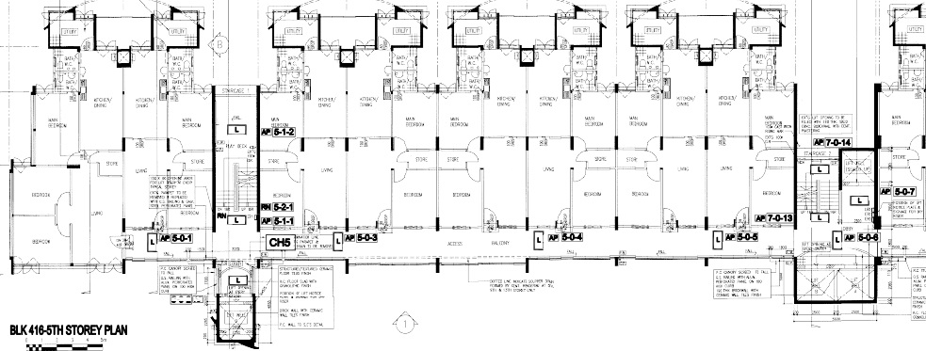
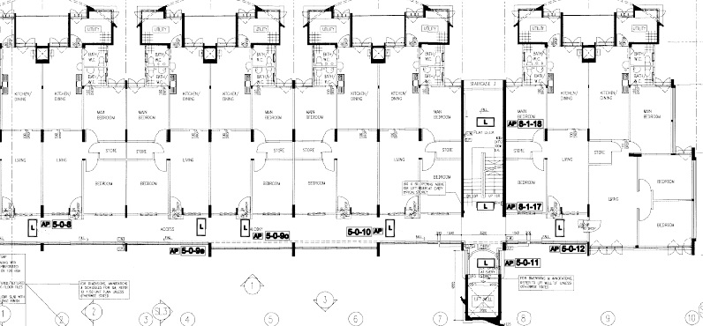
Block 416 3rd TO 4th , 6th TO 8th , 10th TO 12th AND 14th STOREY FLOOR PLAN

Slide 9
STAIR 1
STAIR 2
STAIR 3
1003
1001
999
997
995
993
991
989
987
985
983
981
979
977
975
973
COMMON CORRIDOR
COMMON CORRIDOR
B
A
D
LOBBY B, A
C
LOBBY D
LOBBY C

